Slide 1
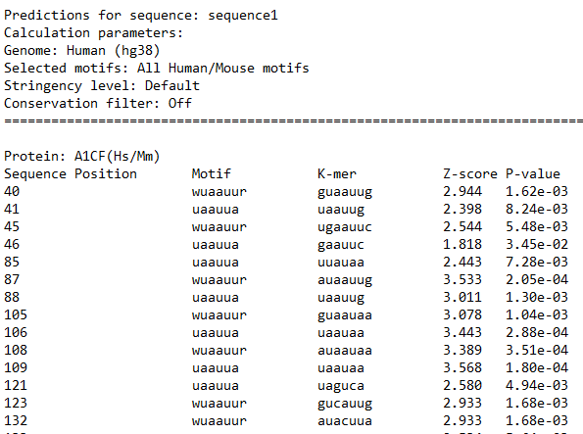
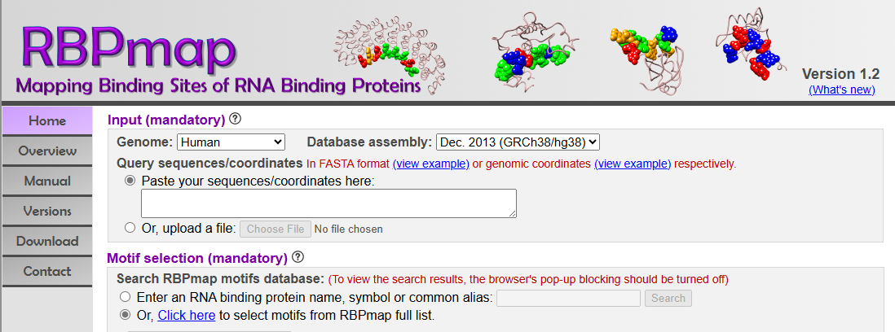
Predicting RNA-binding proteins in Zfr intron using RBPmap
https://pubmed.ncbi.nlm.nih.gov/34694603/
https://rbpmap.technion.ac.il/

Slide 2
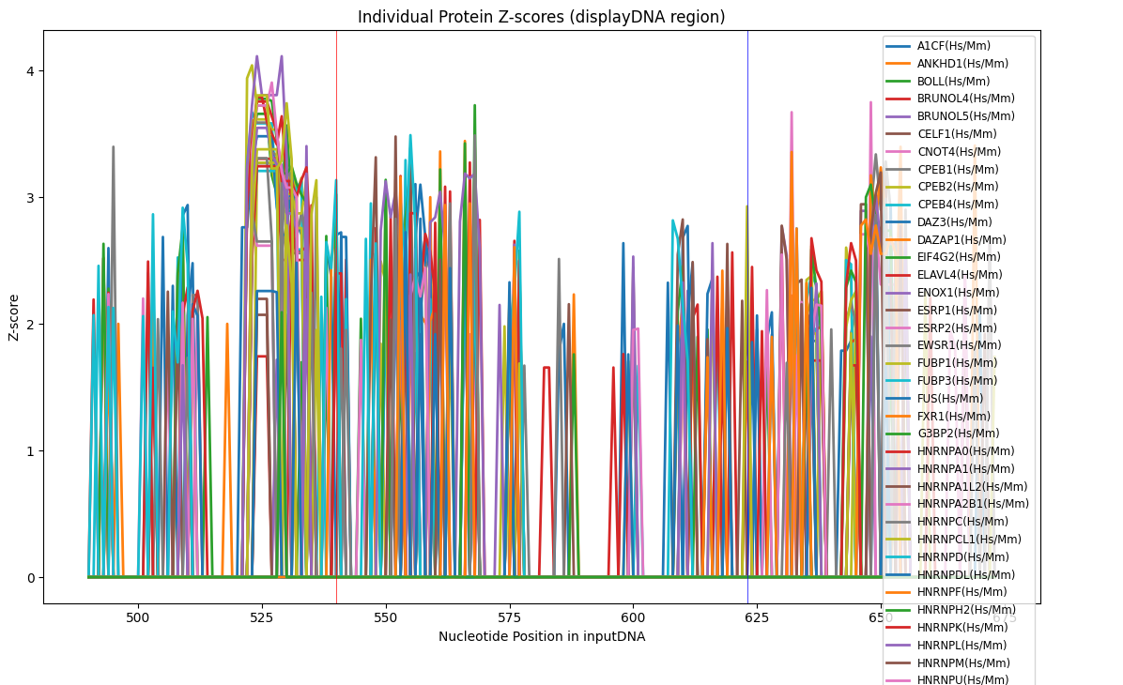
Predicting RNA-binding proteins in Zfr intron using RBPmap
Pseudoexon
Splice acceptor
Pseudoexon
Splice donor
Individual protein Z-scores shown via MatPlotLib
https://rbpmap.technion.ac.il/

Slide 3
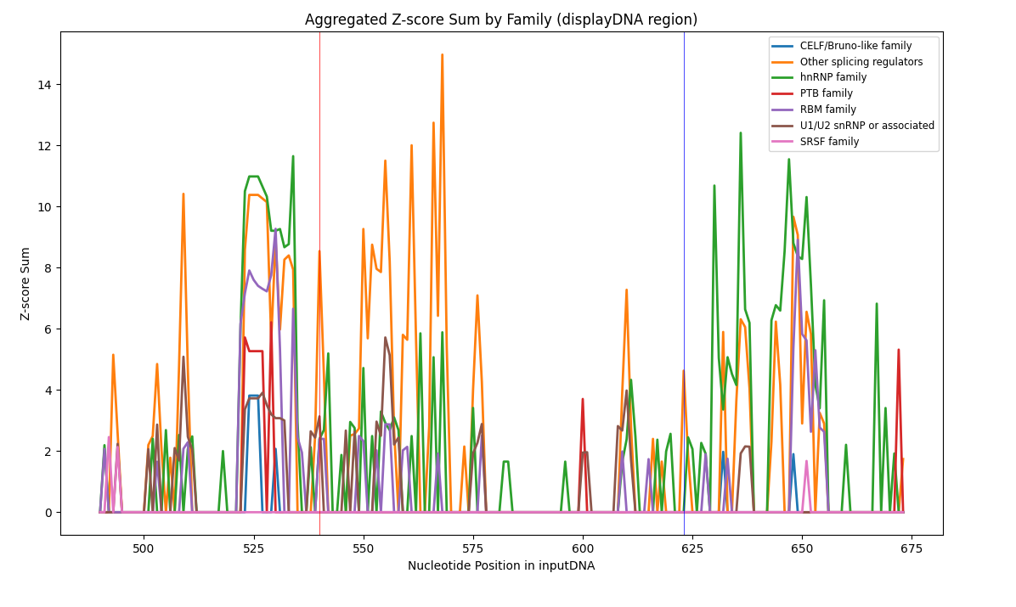
Predicting RNA-binding proteins in Zfr intron using RBPmap
Pseudoexon
Splice acceptor
Pseudoexon
Splice donor
Z-score sums (per protein family)
https://rbpmap.technion.ac.il/

Slide 4
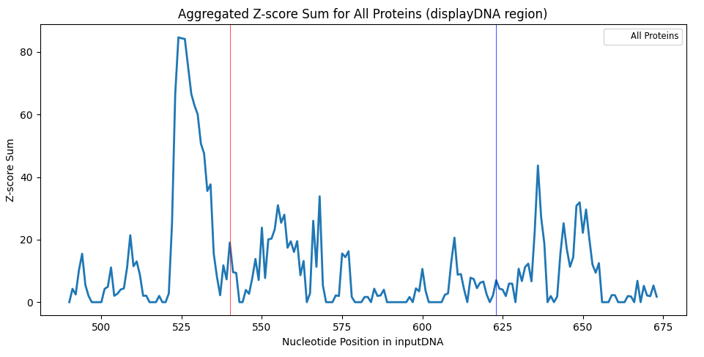
Predicting RNA-binding proteins in Zfr intron using RBPmap
Pseudoexon
Splice acceptor
Pseudoexon
Splice donor
Safe spot for insertions?
Sum of all protein Z-scores
https://rbpmap.technion.ac.il/

Slide 5
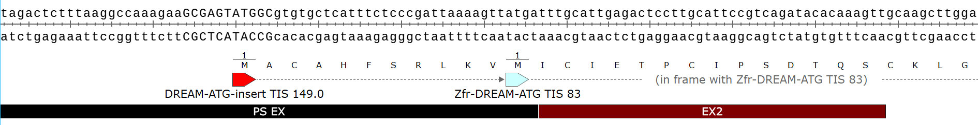
Speculative insertion of in-frame ATG with maximal-strength Kozak within the Zfr pseudoexon
Inserted in-frame ATG
Original Zfr-DREAM-ATG
TIS 149
TIS 83
*Both ATGs are out-of-frame with luc2 if mRNA is unspliced

